Slide 1
Shenzhen Konka E-display Co.,Ltd
Interactive Touch Screen ‖ LED Display ‖ Digital Signage ‖ LCD Video Wall ‖Monitor
https://www.konka-display.com
https://www.konka.com

Slide 2
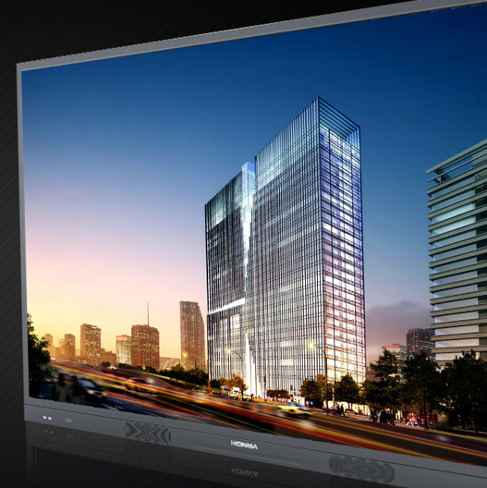
Konka Group
Established in 1980, one of the leading electronic & home appliance enterprise in China.
KONKA brand, China Famous Brand，China Electronics enterprises top 100
Total assets USD 3 billion, the first Sino-foreign electronic Joint Venture after China's Reform and Opening
1st Batch IPO In China, sales revenue USD 8.5 billion in 2020
40 years of professional display accumulation，thousands of people for R & D system

Slide 3
Konka Group Co., Ltd
Electronic: TV, commercial display
Electronic: TV, commercial display
Electronic: TV, commercial display
Electronic: TV, commercial display
Internet operation service
Internet operation service
Fridge, AC, Washing Machine
Fridge, AC, Washing Machine
supply chain service
supply chain service
Mobile phone, AIOT...
Modern logistic service
Products
Service
Modern logistic service
Semiconductor,micro LED,mateial..
Business Unit
Business Unit
....
Industrial park managing
Industrial park managing
Direct investment fund
Direct investment fund
Industrial
Financial
Headquater eco managing
Headquater eco managing
Venture capital fund
Business Unit
Business Unit
Logistic park managing
Logistic park managing
Investment and merger fund
...
...
Commercial factoring

Slide 4
Shenzhen Konka E-display Co.,Ltd
Established in June 2001, Shenzhen KONKA E-display is one of subsidiary company of KONKA group, and specializing in the R&D,production,sales and service of interactive touch panel which wildly used in smart education and intelligent conference room, digital signage, LCD/LED display, monitor and so on.
Devotes to build international competitiveness with advanced technology and excellent quality control system， KONKA E-display has developed full range of commercial display products to meet our partner’s various requirements.
Konka mature global
Service Network
Remarkable YOY growth on main product ranges
Products exported to more than 90 countries
20 years accumulation in commercial display

Slide 5
01
Core Advantage
Content
02
Product Range
03
Website and Contact

Slide 6
01
Core Advantage

Slide 7
Core Advantage
R&D
Production
1、Nearly 200 invention patents
2、Independently developed main board ， firmware & information publishing system…
1、Three main production bases in China, Anhui factory, Dongguan factory, Kunshan factory. Commercials display mainly produced in Dongguan factory.
2、Global production, Egypt, Mexico, Poland.
Quality Control
Service Network
1、ISO9001 / ISO14001
2、A variety of products were selected for the list of national energy-saving products
1、National 3000+ after-sales outlets, 400 after-sale telephones, City coverage 100% in China
2. Profecsional engineering support for overseas

Slide 8
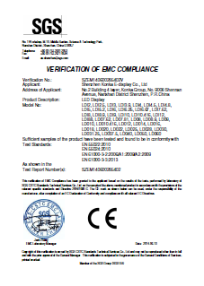
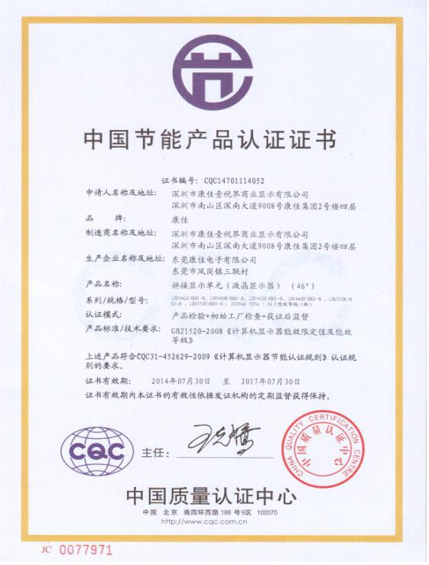
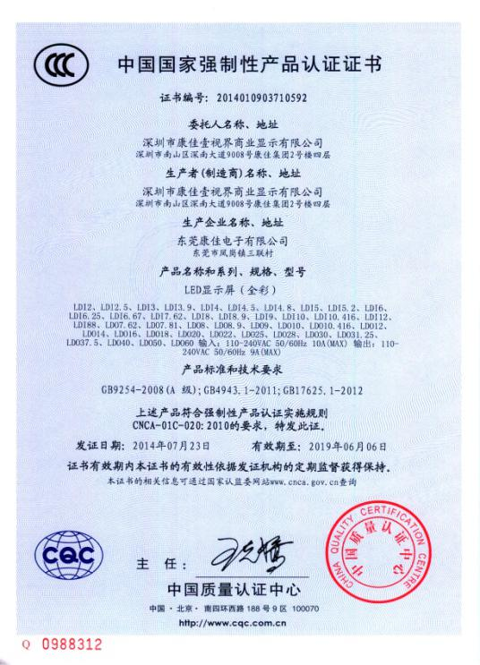
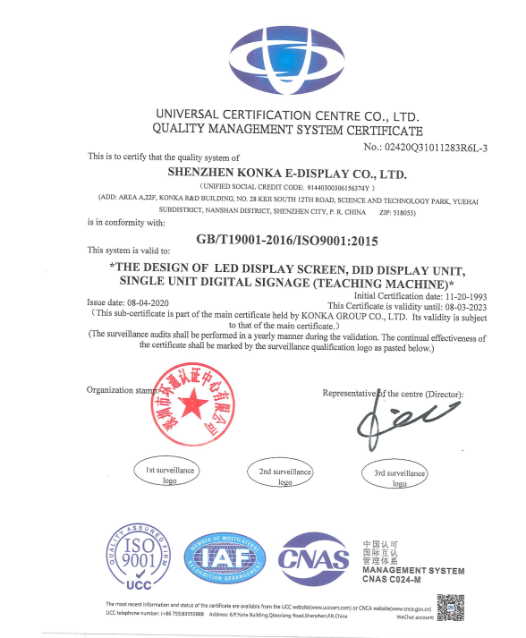
Quality / Certificate
CE
Energy Saving Certification
FCC
ISO9001
CCC
Pass for all the Certificates

Slide 9
Production (Commercial display production Base)
Konka Dongguan Factory
Built in 1993, 26years experience accumulation.
Factory Area 250000㎡, 9 SMT lines, 6 module lines with clean room and 10 assembling lines.
LED products have a monthly capacity of more than 3000m2
Konka Dongguan Factory
制造体系-—大中央制造系统
The largest LCD product line newly built in 2015, with a single line length of 400 meters. Monthly production capacity increased by 50%
New factory is under construction which is 5km away from the current one, it will be ready in 2022 with full new automatic facilities.

Slide 10
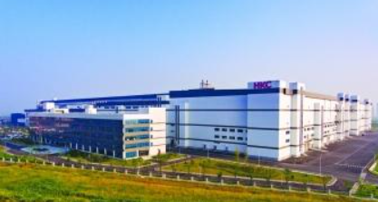
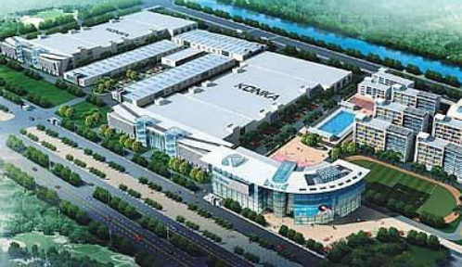
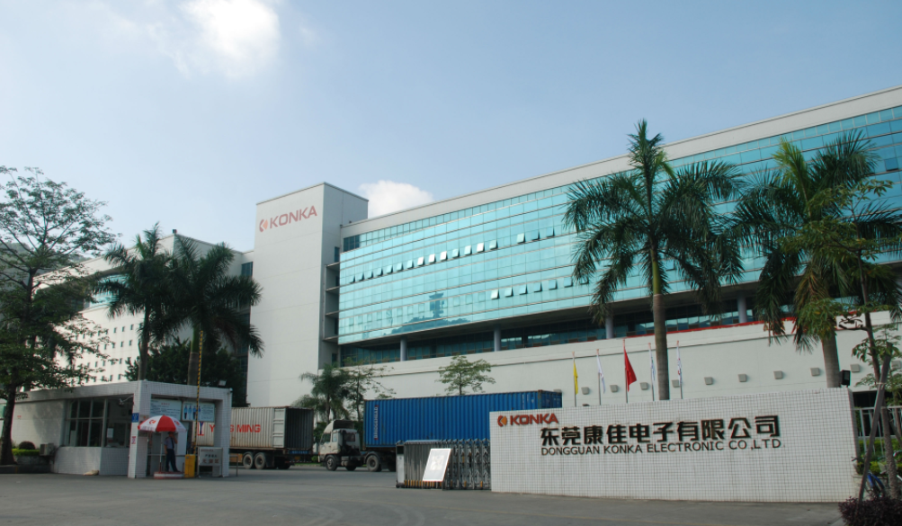
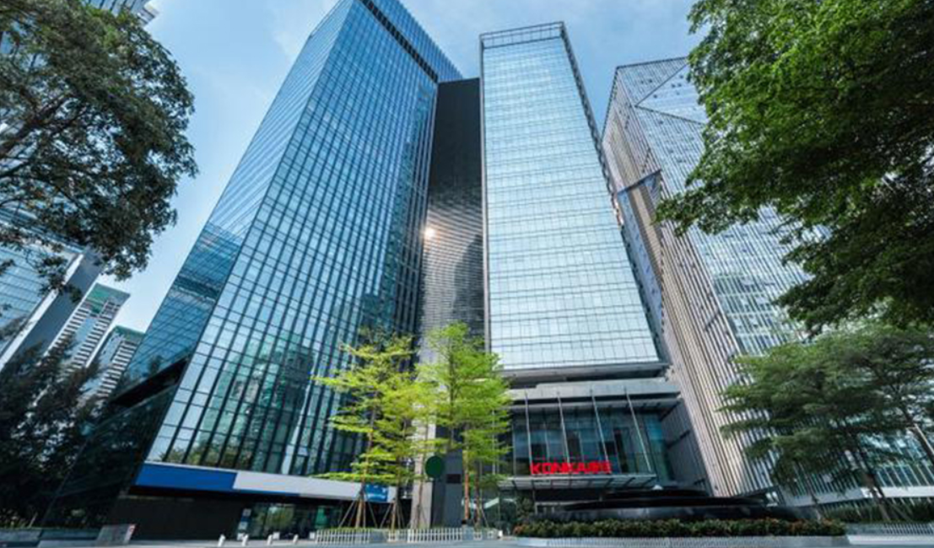
Factory for Display
Anhui Konka
Founded in 1997
Staff:4000
Factory Area:350000 m²
SMT Lines: 9 Panel Lines:8 CBU lines:12
Production capacity:8000000 pcs/y
Kunshan Konka
Founded in 2008
Staff:2000
Factory Area:100000 m²
SMT Lines: 7 Panel Lines:7 CBU lines:7
Production capacity:4000000 pcs/y
Chuzhou
Kunshan
Dongguan Konka
Founded in 1993 Staff:2500
Factory Area:250000m² SMT Lines:9
Panel Lines:6 CBU lines:10
Production capacity:5000000 pcs/y
Dongguan
Shenzhen
Konka Headquarter
Address: Konka R&D Building, No.28 Keji South 12th Road, Nanshan district, Shenzhen city, Guangdong, P.R.China
www.konka.com
www.konka-display.com
Other factories which produce mobile phone, A/C, Fridge, washing machine, Micro LED and others, are not introduced with details here.

Slide 11
Service Network
Poland cooperated plant
China, 7 regional service platforms
30+ branch, 3000+ after-sales outlets, 100% city coverage
KONKA US branch
KONKA Egypt factory
production, sales
and service localization
Mexico cooperated plant
India cooperated Plant
Quick and professional response for overseas support.

Slide 12
02
Product Range

Slide 13
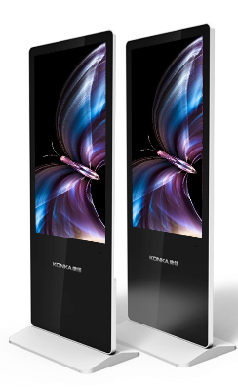
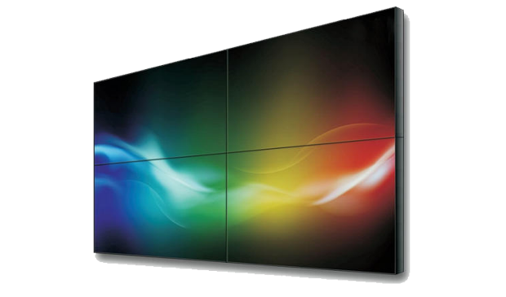
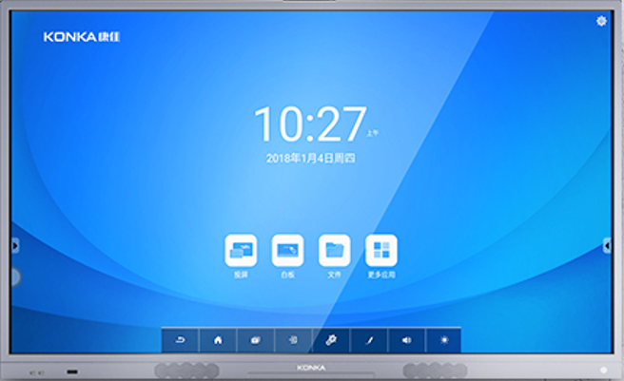
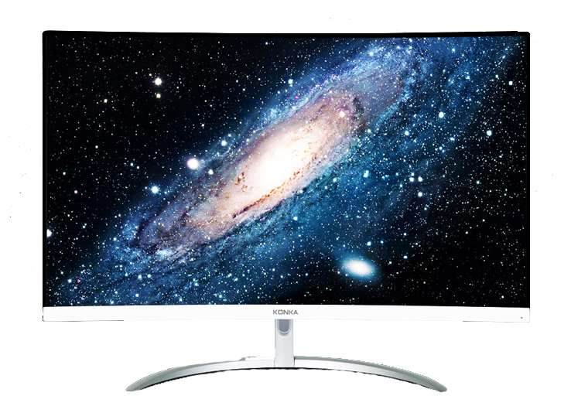
Main Products
Interactive Touch Panel
Digital Signage
LED Video Wall
LCD Splicing Wall
Monitor
Smart Pass
+
+
Hardware + software
Product + Proposal

Slide 14
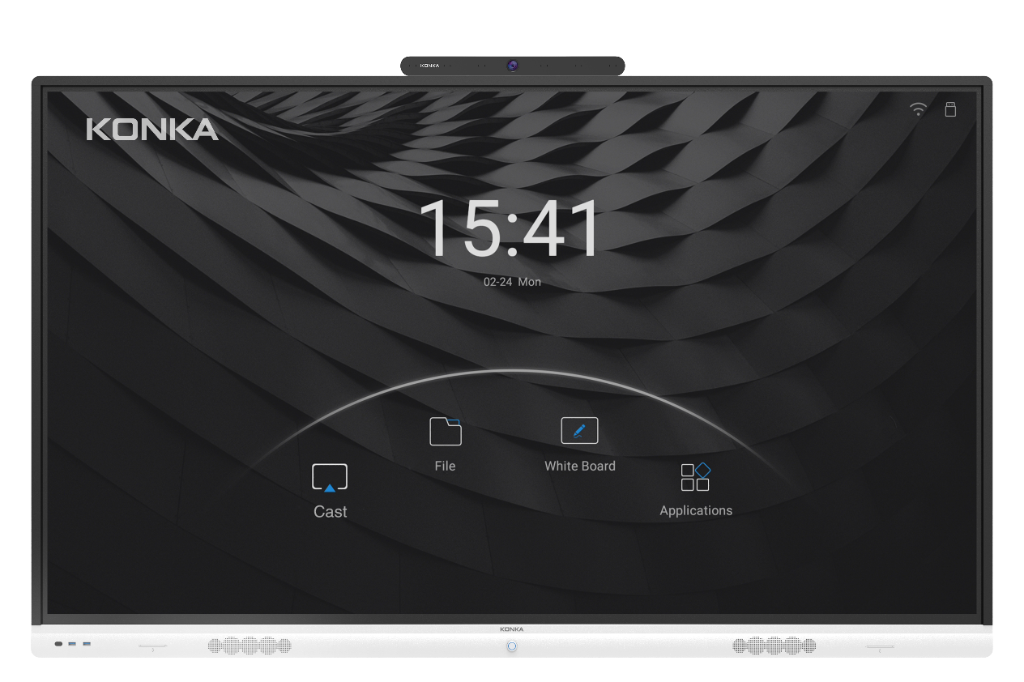
Interactive Touch Panel
IR Touch / P-CAP
Android 9.0/8.0
Air bonding, optical bonding
Size: 55”,65”,75”,86”,98”

Slide 15
Electronic whiteboard
Fluently writing
Mirror Casting
QR code
sharing and storing
20 points
simultaneous writing
synchronization& Annotate at
any terminal

Slide 16
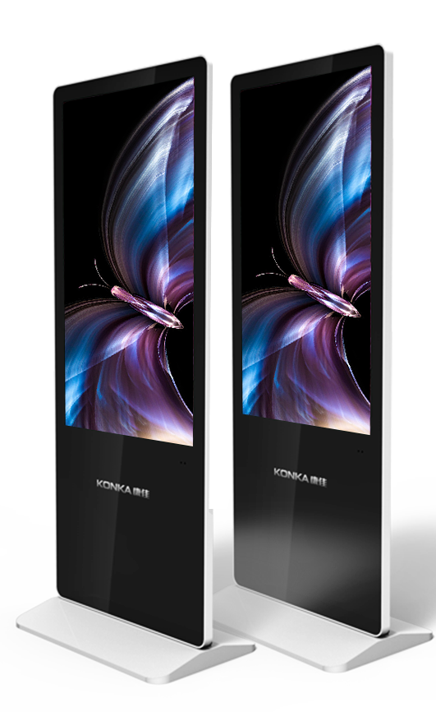
Digital Signage
Wall-mounted ultra-thin poster
Floor-standing poster
K-shape digital signage
Outdoor digital signage
Digital class-board

Slide 17
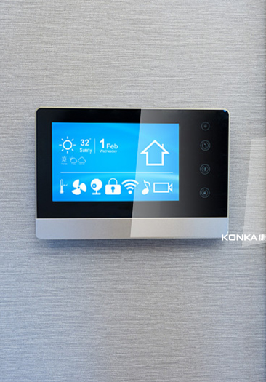

Slide 18
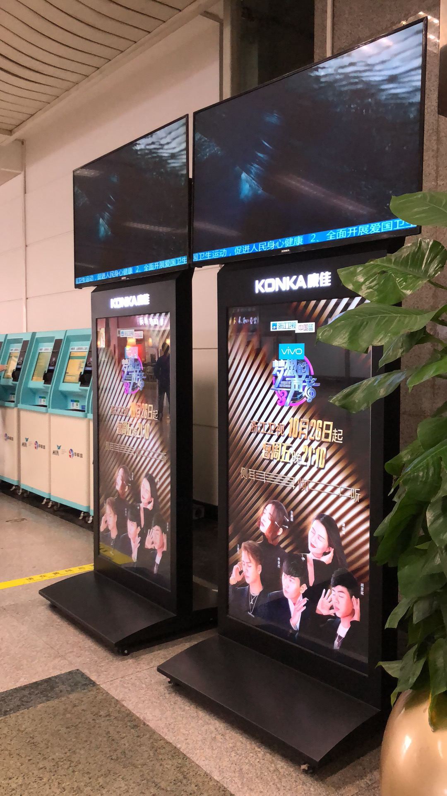
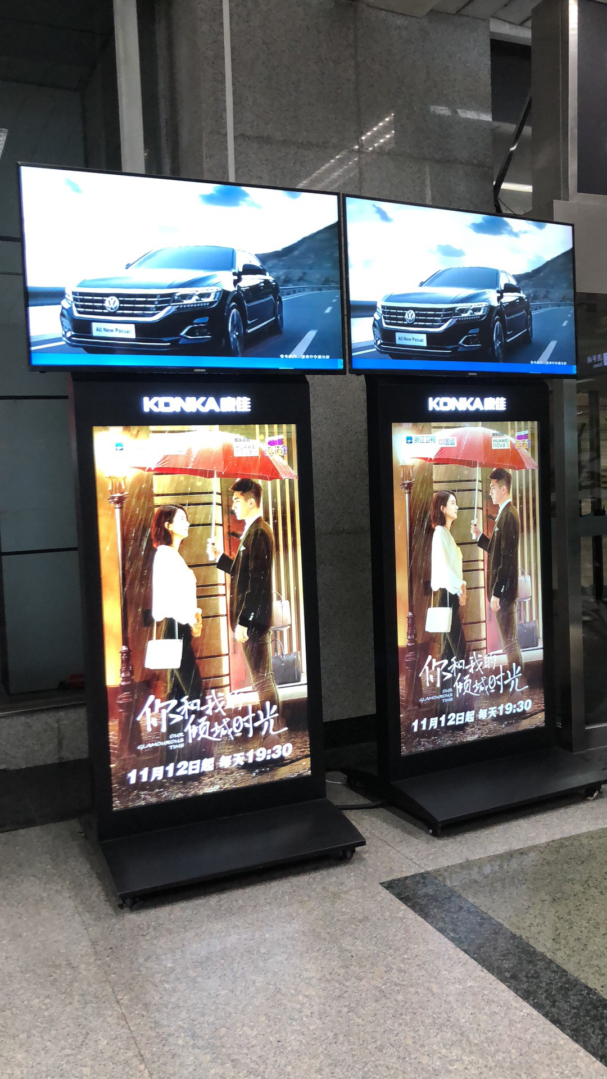
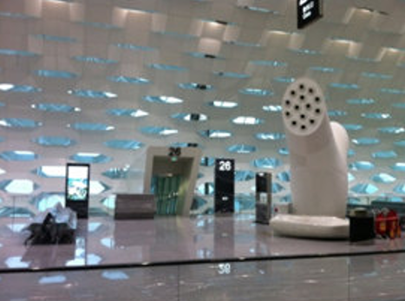
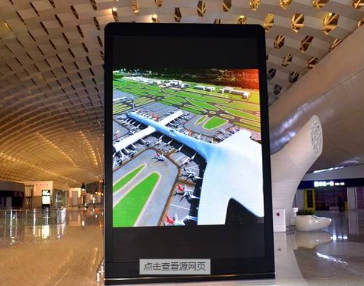
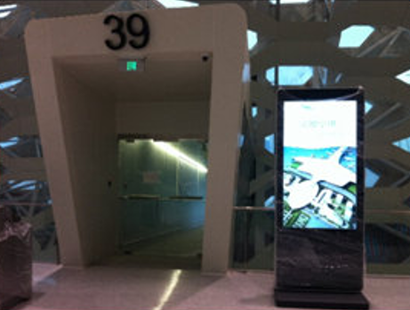
Hangzhou international airport

Slide 19
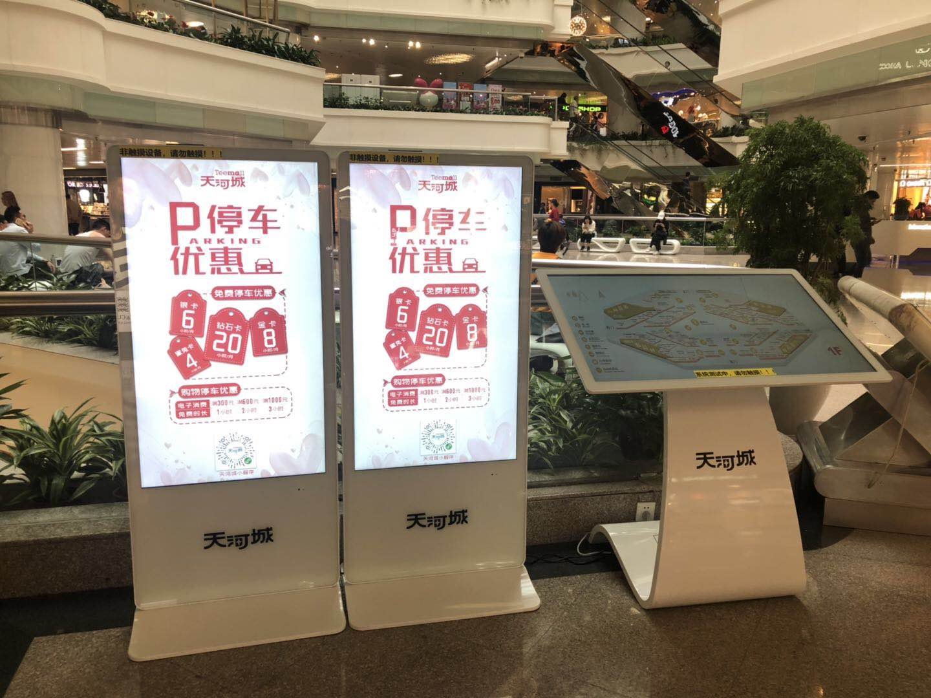
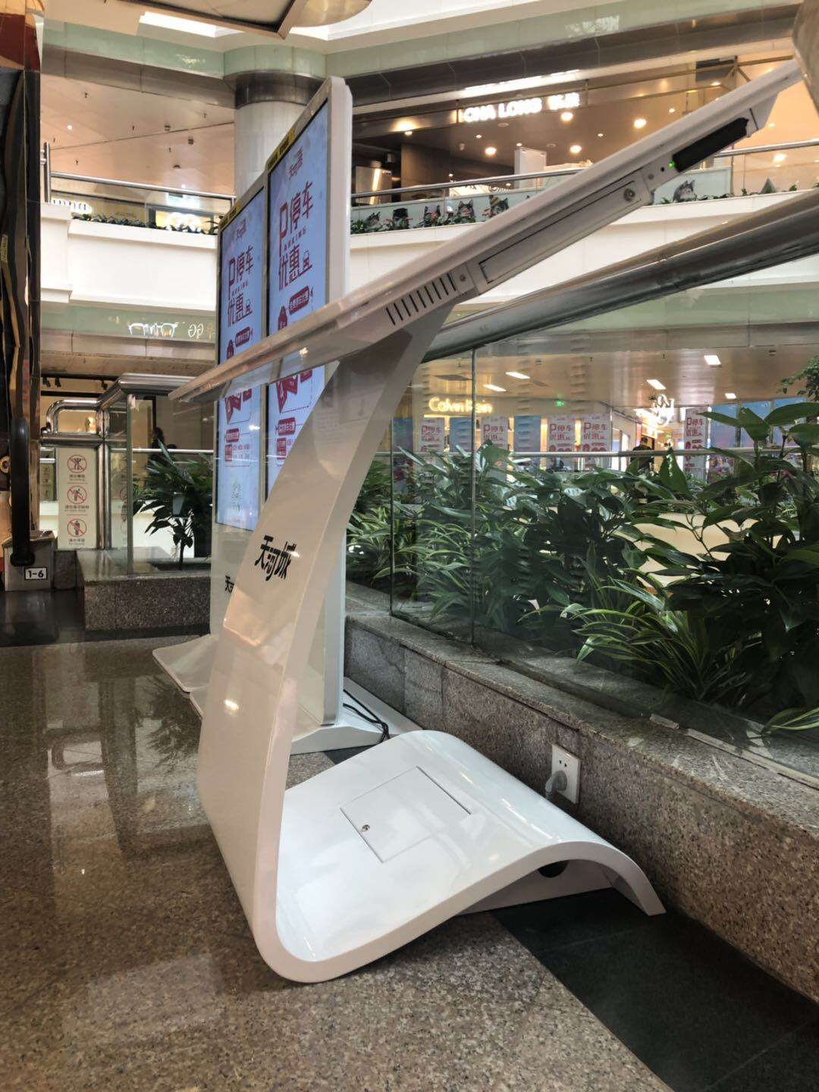
Guangzhou Tianhe Shopping Mall

Slide 20
LED Video Wall
HD small pixel pitch
Fixed installation
Rental
Optical Grating
Customized series

Slide 21
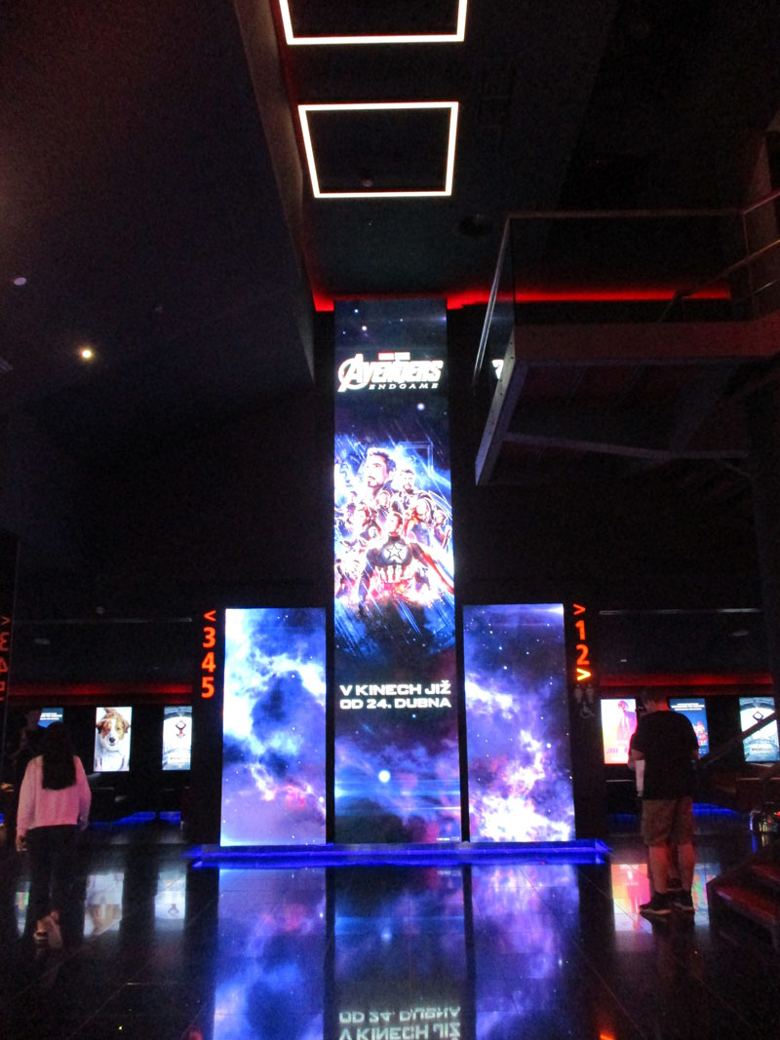
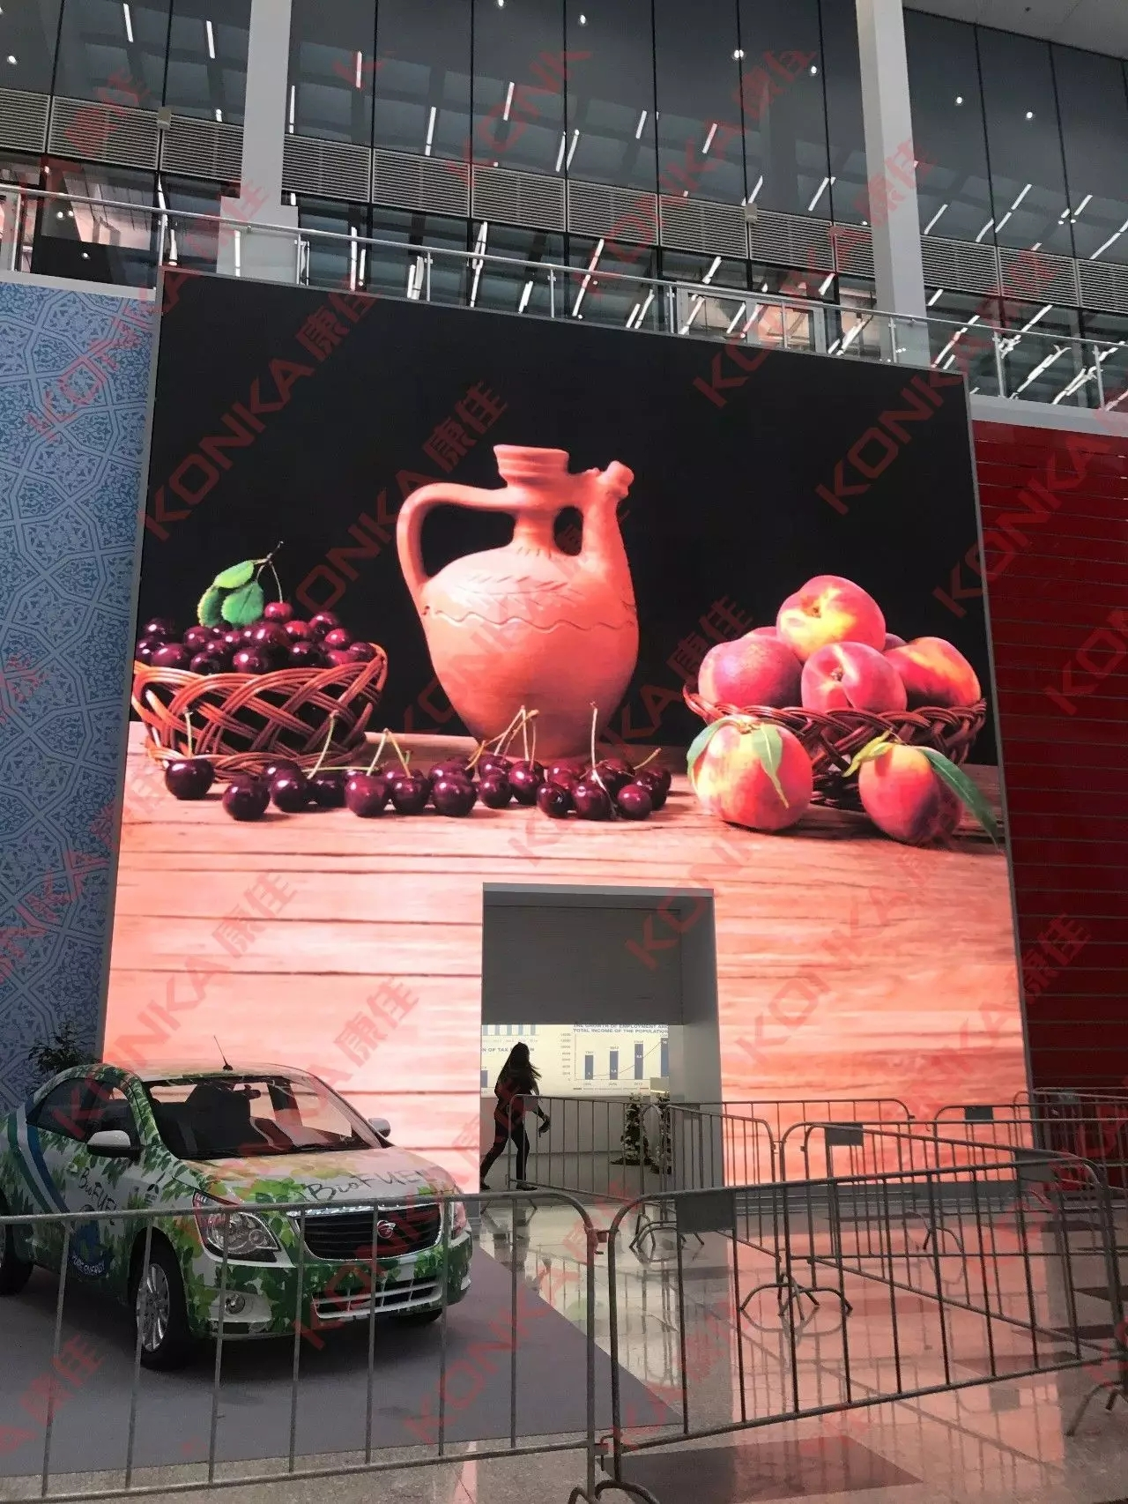
Poland Cinema
Greek TV station
Uzbekistan World Expo

Slide 22
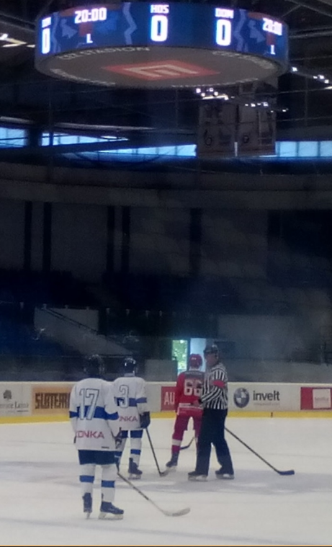
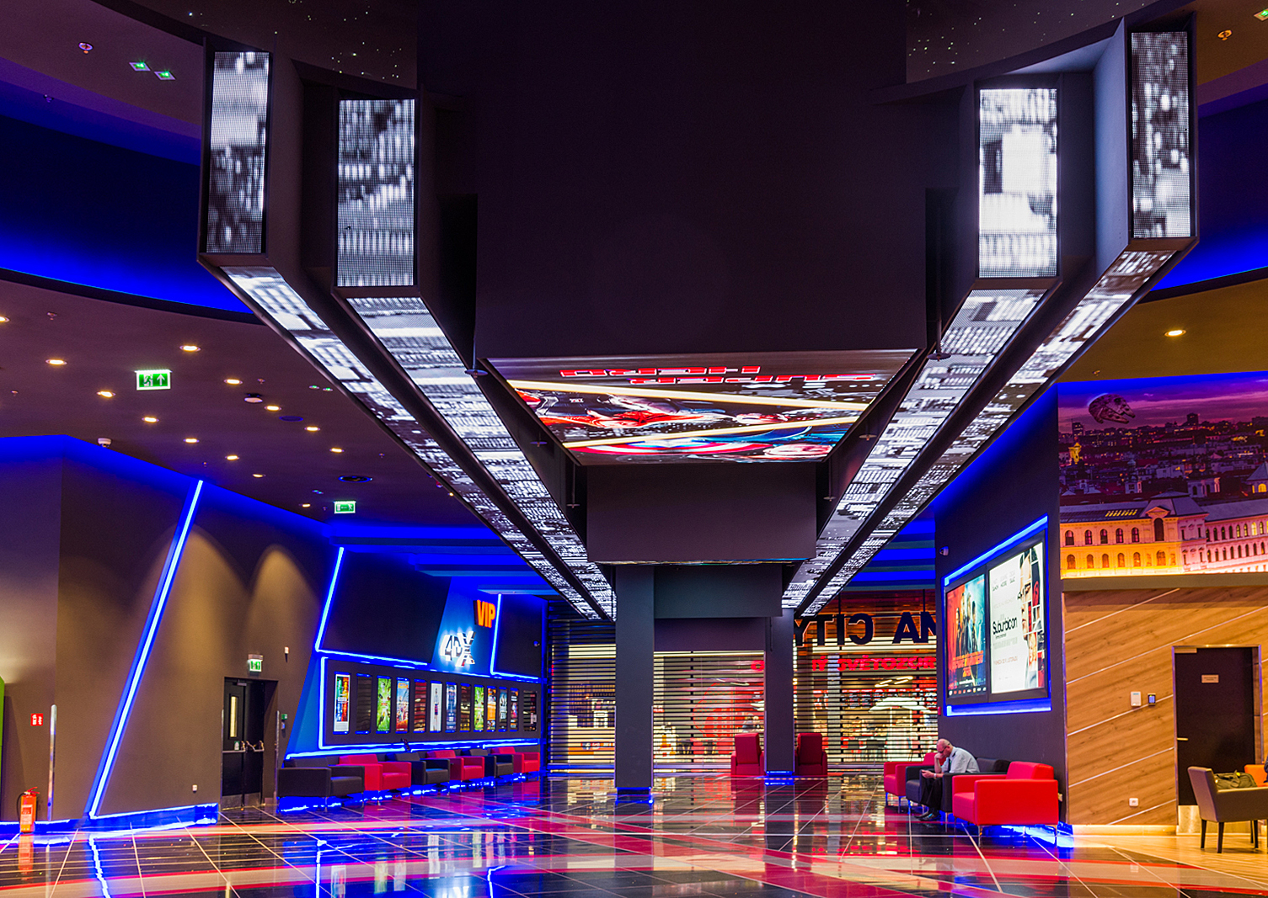
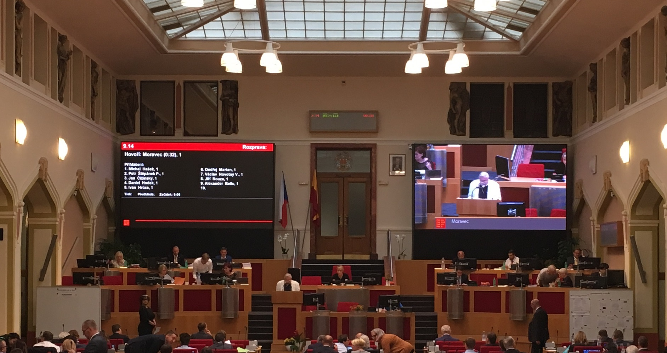
Czech Indoor Ice Hockey Hall
Czech cinema
Czech parliament building

Slide 23
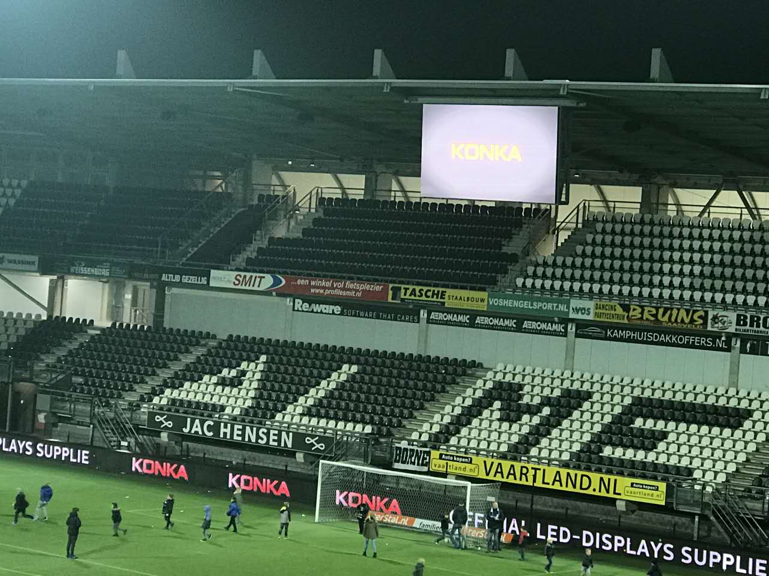
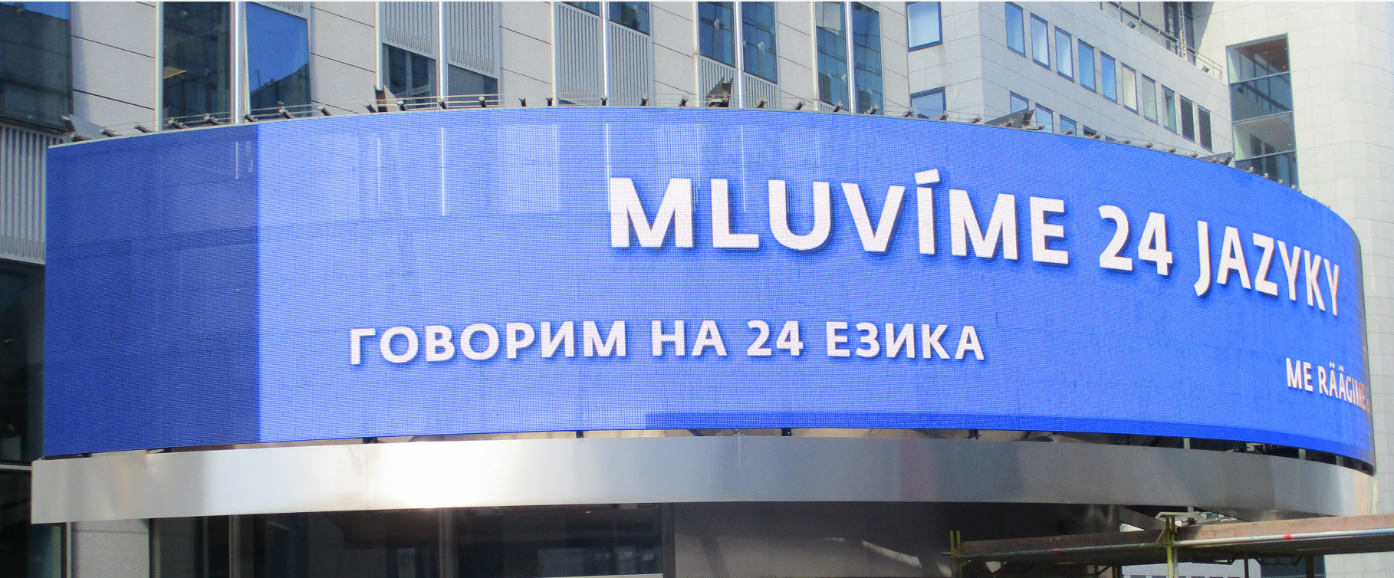
Netherlands stadium
Euro Parliament building

Slide 24
LCD Splicing Video Wall
0.88mm bezel
1.88mm bezel
3.5mm bezel

Slide 25
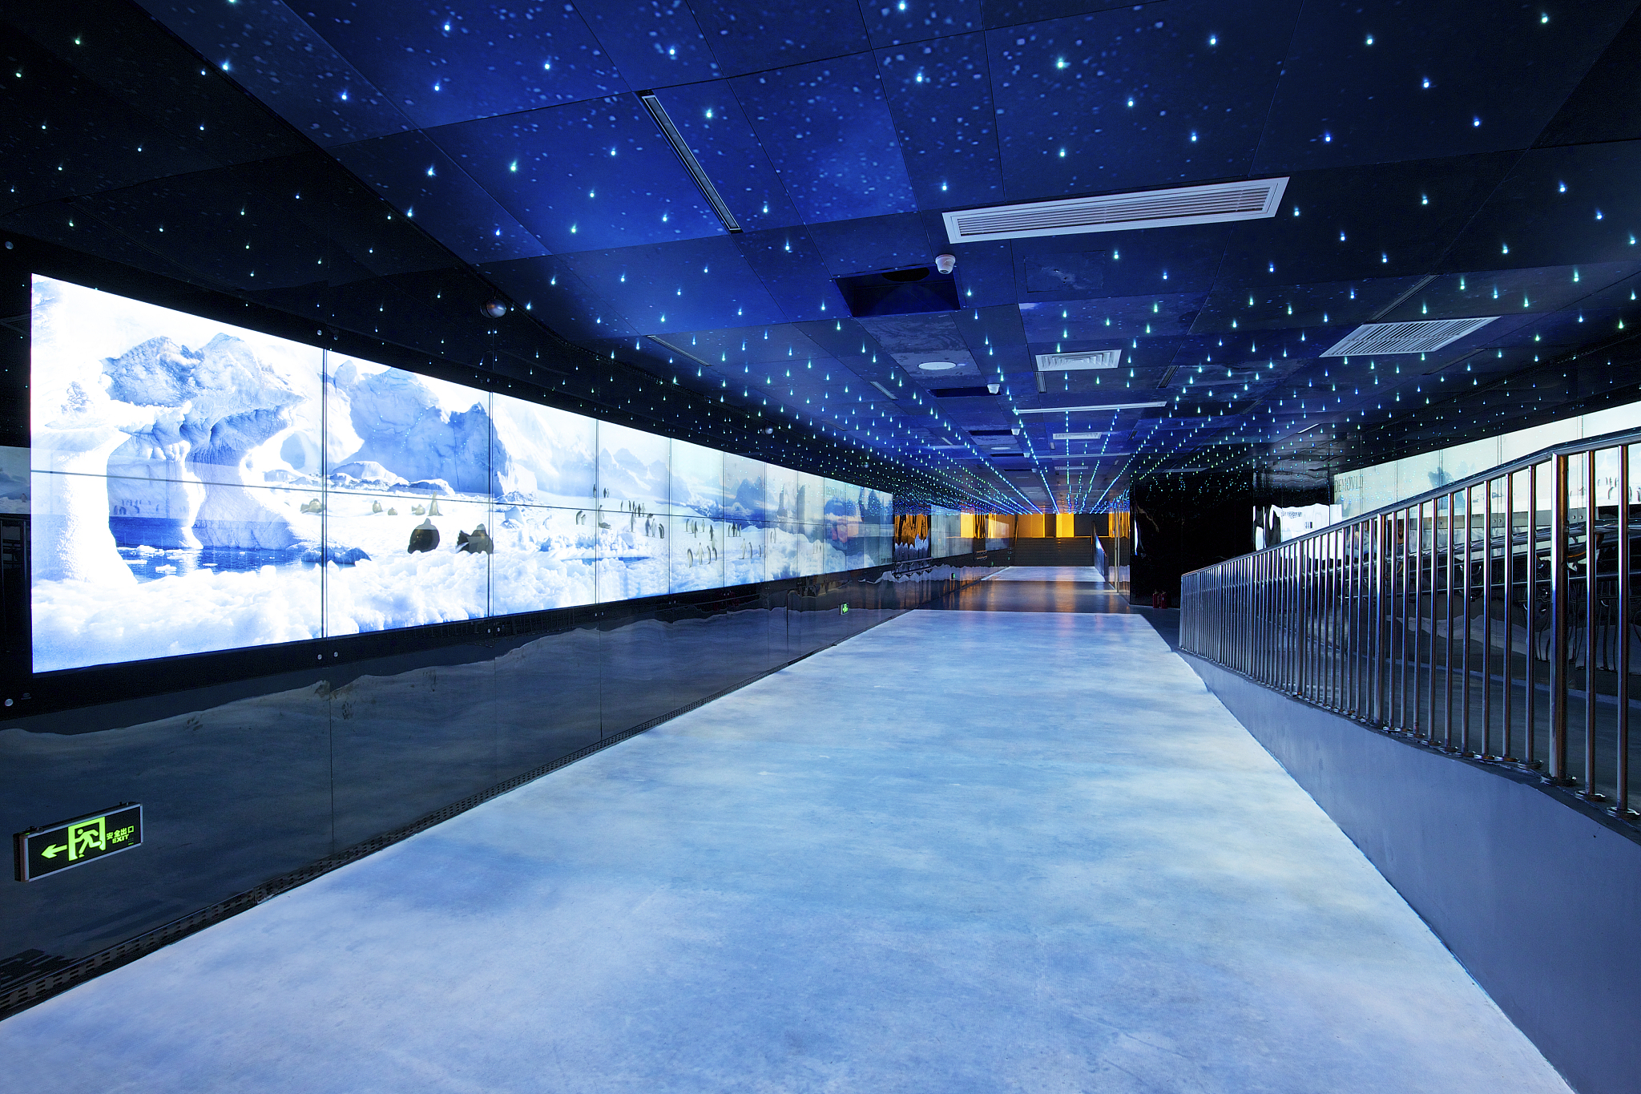
液晶拼接屏
1. 液晶拼接屏
0.88mm拼缝
1.7mm拼缝
3.5mm拼缝
2. 液晶监视器
9时至84时常规规格
1, Professional chip
2, Intelligent light control
3, Smart adjustment
4, Split screen
5, 3D noise reduction
6, HD resolution
7, 178 ° wide viewing angle

Slide 26
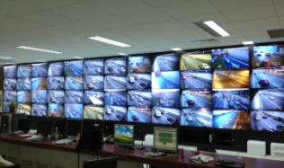
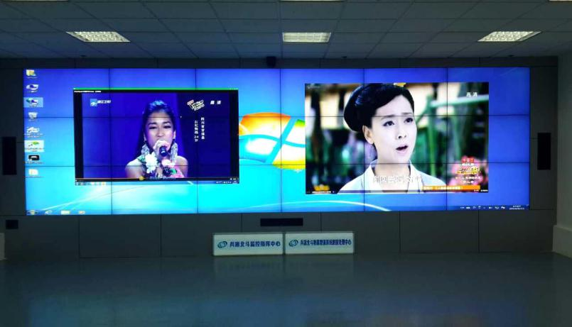
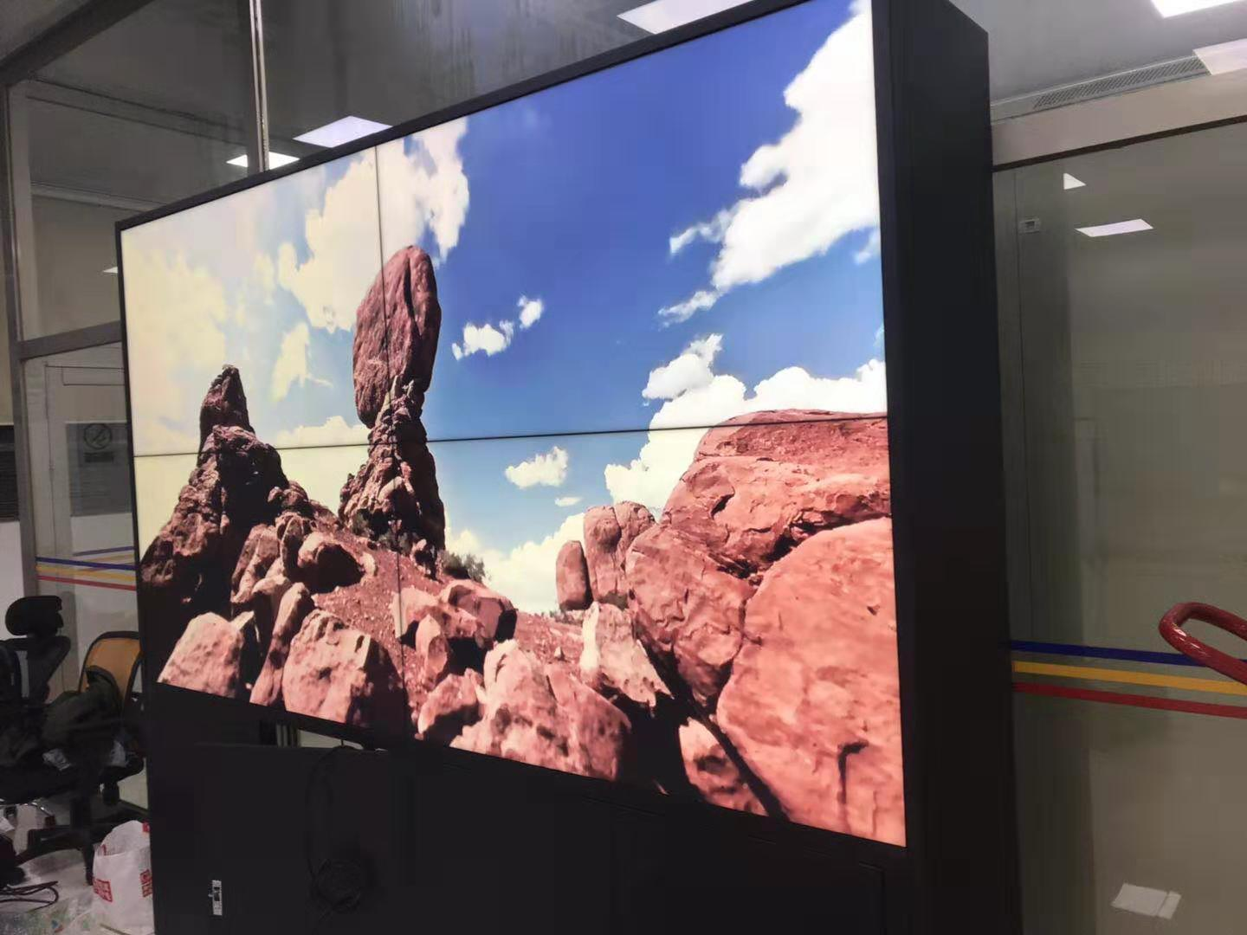
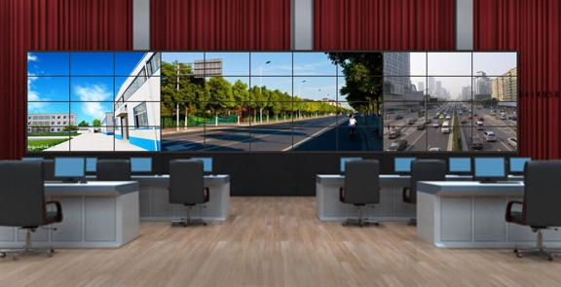
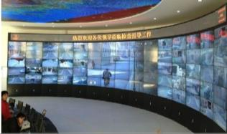
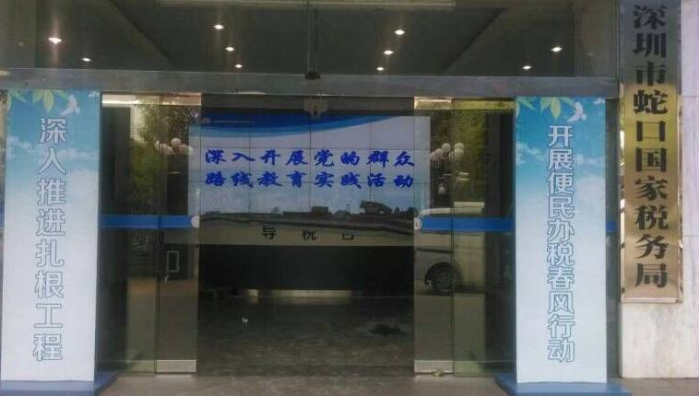
Suzhou high-speed monitoring
China North Industries Navigation Command Center
Shenzhen Qiaocheng Hydropower Monitoring System
Beijing Yanqing Thermal Power Enterprise
Wuxi government “Inner ring" screen
Shenzhen National Taxation Bureau Information System

Slide 27
Monitor
1800R Curvature
Micro Border
Slim Body
WVA

Slide 28
Smart Pass
Android9.0 system
Industrial-grade dual-camera
Infrared thermal imaging module
Mask recognition
Temperature detection
Working attendance
Access control

Slide 29
Info Publishing System
Centrol Control
Store Managers
TV
Computer Room
Monitor
Cloud acceleration
Switch
Info Publishing terminal
Operating Team
TV
Monitor
Interface server
Switch
Info Publishing terminal
Store manager
Ethernet cable
HDMIT/VGA/AV cable

Slide 30
03
Website and Contact

Slide 31
Website and Contact Information
Shenzhen Konka E-display Co., Ltd
sales@konka-display.com www.konka-display.com

Slide 32
Thanks

