Slide 1
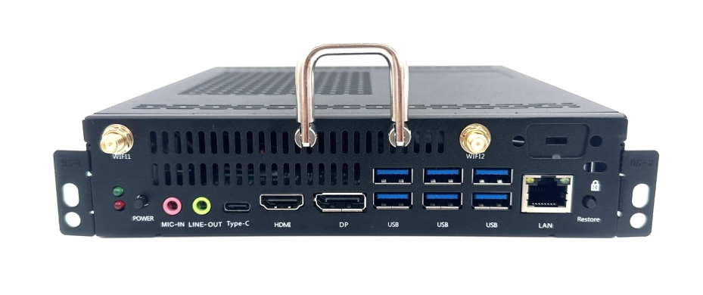
OPS i5-1130G7
Functional features
Support 11th Gen Intel ® Core ™ Processor
Display interface: HDMI/DP, support sync dual display, async Triple display
Support TPM2.0
Support JAE 80PIN HDMI2.0 Output
Support onboard LPDDR4x memory and M.2 SSD storage
Support Wake on Lan, PXE startup & scheduled boot
Support one-key backup and restore system
Specification Parameters
Configuration | CPU | 11th Gen Intel ® Core ™ CPU
 | Memory | LPDDR4x 8GB 3733Mhz Memory
 | Storage | M.2 2280 support NVMe protocol
 | GPU | Intel® Iris® Xe Graphics
 | Display | 80Pin Rear HDMI/Front HDMI/Front DP, support sync & async display
 | Network | LAN | 1* 8111H 10M/100M/1000M Ethernet
 |  | Wifi | 1* M.2 2230 for Wifi+BT
 | Audio | Realtek ALC897 Audio 5.1 Channel
I/O | Front | 1*HDMI2.0 out 1*DP1.4 out 6*USB 3.2Gen1 1* RJ45 1*Type-C(USB2.0） 1*Power 1* Restore 1*Line_out 1*Mic_in 1*Power LED 1*SSD LED 2*WIFI/BT ANT
 | Back
 |  | 1* JAE 80PIN：HDMI2.0 out(4K/60Hz)
Power | Input | 19V4.7A(55±10W)
Size | Host（mm） | 195*180*30/42mm |  | Packing box：282*258*77mm
 | Weight（kg） | N.w≈1.2 Kg G.w≈1.4Kg
Temperature and Humidity | Working Temperature | 0°C~ 45°C
 | Storage Temperature | -40°C~ 80°C
 | Working Humidity | 10% - 95% @40°C No condensation
OS | Supported OS | Windows 10/11, Linux

