Slide 1
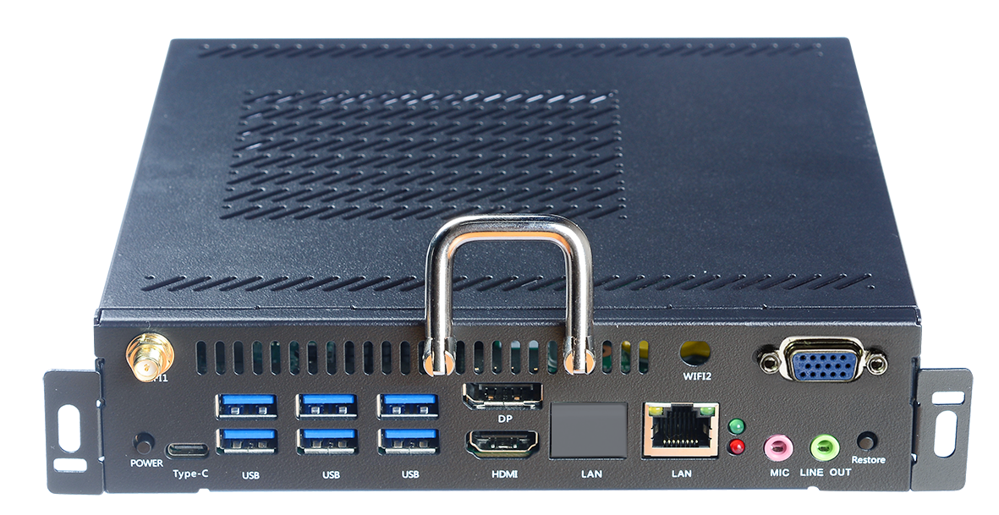
OPS- I7 10750H
Functional features
Supports Comet lake-H 10th Gen Intel® Core™ i5 i7 processors
The display has HDMI/DP interface and supports The display has
SSD mSATA+ SATA HDD，dual channel
Compatible with OPS-C full range of product upgrades, switching
Supports dual-channel SO-DIMM DDR4 memory and M.2 SSD storage
BIOS supports AMI 64Mbit diskless boot, power on, timed boot
Support JAE 80Pin connection interface
Hardware support one-key restore system function
Specification parameters
CPU | CPU | Intel Comet Lake-H I7-10750H processors
 | BIOS | AMI 64Mbit
RAM | DDR4 | 1 X DDR4 2666MHz 8GB memory
Storage | M.2 | 1*M.2 2280 interface supports NVME and SATA dual protocol (256GB SSD)
 | SATA | 1* 2.5" SATA HDD/SSD
Display | Graphics card | Intel® UHD Graphics
 | Output | HDMI | I/O port HDMI output support 3840*2160@30Hz
 |  | DP | I/O port DP output support 3840*2160@ 60Hz
 |  | OPS-HDMI | 80 Pin Socket HDMI output support 3840*2160@ 60Hz
Audio | Audio | Support 1*LINE-OUT ，1*MIC-IN 80Pin support LINE-OUT+MIC
Internet | LAN | Realtek RTL8111H 10M/100M/1000M Ethernet
 | WIFI | 1*M.2 2230 for Wifi+BT
SIO | FAN | Support automatic fan adjustment
Other | POWER | Power button
 | RESET | Reset button
USB | USB3 .0 | 6*USB3 .0 1*TYPE-C
Adapter | Input | DC19V/4.74A
Size | A | 195*180*42mm
Environment | Working temperature: 0-45°C Storage: -40~80°C
 | Humidity 10%~95%@40℃ No condensation
OS | Operating systems | Windows 8/10/11, Linux

