Slide 1
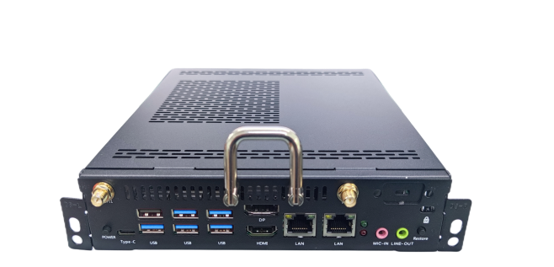
Functional features
Support 12th Generation IntelliGent Inter®Core™ i5 i7 processor
HDMI/DP/Type-c Support synchronous dual display. Asynchronous three display
Support TPM2.0
BIOS Support AMI 256Mbit Non-disk Boot 、On Power up、Timing boot
Support HDMI 2.0 output+JAE 80PIN HDMI 2.0 output
Support Double Channel SO-DIMM DDR4 Memory and M.2 SSD Storage
Support JAE 80PIN connecting interface
Specification parameters
Standard parameters | CPU | 12th Gent Intel ® CoRE ™ Processor
 | Memory | 2 x SO-DIMM DDR4 2666/3200MHz 4GB Memory
 | Storage | 1*M.2 2280 Interface support Support NVMe and SATA Dual protoco (Manual switching)
 |  | 1* 2.5" SATA HDD/SDD
 | Graphics Card | Intel® UHD Graphics
 | Display port | HDMI/DP/Type-c synchronous dual display & Asynchronous three display
 | Network | LAN | 1* Intel I226-V 2.5G Ethernet 1* 8111H 10M/100M/1000M Ethernet
 |  | WIFI | 1*M.2 2230 for Wifi+BT
 | Audio | Cmedia USB Audio（HS100B）
I/O port | Front interface | 1*HDMI2.0 out 1*DP1.4 out 5*USB 3.0 1*USB2.0 2* RJ45 1*Power 1* Reset 1*Line out 1*Mic in 1*Type-C(USB 3.0+video transmission）1*Power LED 1*HDD/SSD LED 2*WIFI/BT ANT
 | Rear interface
 |  | 1*JAE 80PIN：HDMI2.0 out(4K/60Hz)
Power | Input | 19V4.7A
SIze | Host Size（mm） | Host machine: 195*180*42mm |  | Single package size：282*258*77mm
 | Weight（kg） | Net weight≈1.2 Kg Gross weight≈1.4Kg
Temperature and Humidity | Operating Temperature | 0°C~ 45°C
 | Storage Temperature | -40°C~ 80°C
 | Operating Humidity | 10% - 95% @40°C (non-condensing)
System | Operating System | Windows 10/11, Linux
Order information
Laptop 12th processor | I5-1235U | I7-1255U
DDR4 Storage /RAM | Optional 4G/8G/16G/32G
Hardisk/SSD | Optional SSD 128G/256G /512G/1TB / HDD 1TB

